Slide 1
scRNA-Seq Pilot Study & Public Dataset Comparison
2022.04.15 – Nathan T. Johnson

Slide 2
scRNA-Seq Pilot
Previously
Analyzed H3 scRNA-Seq Pilot Study
Compared Pilot Study to PMBC dataset
Feedback: Analyze Public Datasets that Mimic Pilot Study
To verify H3 analysis pipeline capable of capturing the main patterns
To That End: Identified & Analyzed 2 Public Datasets:
Analysis of Single-Cell RNA-Seq Identifies Cell-Cell Communication Associated with Tumor Characteristics (SRP166967)
Analysis of Single-Cell RNA-Seq Identifies Cell-Cell Communication Associated with Tumor Characteristics (SRP262589)
Rationale
SRP166967: CT26 & Comparison across multiple Mouse Tumor Models
SRP262589: CT26 / Enriched for CD45+ Cells / Drug Treatment

Slide 3
Pilot Study Design Reminder
Number of tumors: 13
Groups: Vehicle (3 mice) and HER2-STING (10 mice)
Dose and treatment time: 1 mg/kg IV of 24-hr treatment
Anticipated number of CD45+ cells
Vehicle: 9 million
HER2-STING: 4.3 million
Submit 3 x 0.5 million cells of the vehicle group sample and 3 x 0.5 million cells of the HER2-STING group sample to MIT on ice in the afternoon
Freeze 3 x 1 million cells of the vehicle group sample and 3 x 1 million cells of the HER2-STING group sample in freezing media and ship to BGI.

Slide 4
scRNA-Seq Pipeline Logistics
H3 Pilot scRNA-Seq
Public Dataset
BGI
MIT
Download & Preprocessing
Prep Data
*Costs ~$45 per sample in computational costs
Quantify & Basic QC (Cell Ranger)
Filter On:
# of Genes Expressed: >200
Expression Amount: >1,000 reads
% of Mitochondrial Contamination: <5%
Extensive QC & Filtering
AWS: Cloud Computing Implemented
S3 Bucket Stored
Feature Reduction & Cluster Analysis
SingleR Cell type calling:
Definition of >400 cell culture Microarray
High expressed genes = cell type definition
Cell Type Calling

Slide 5
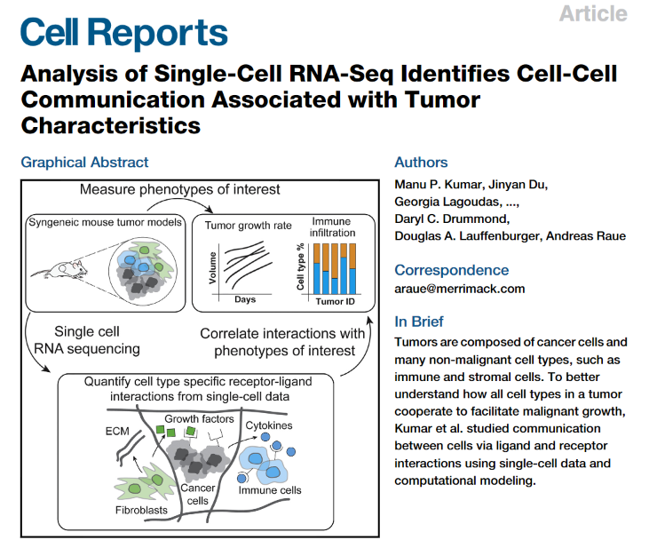
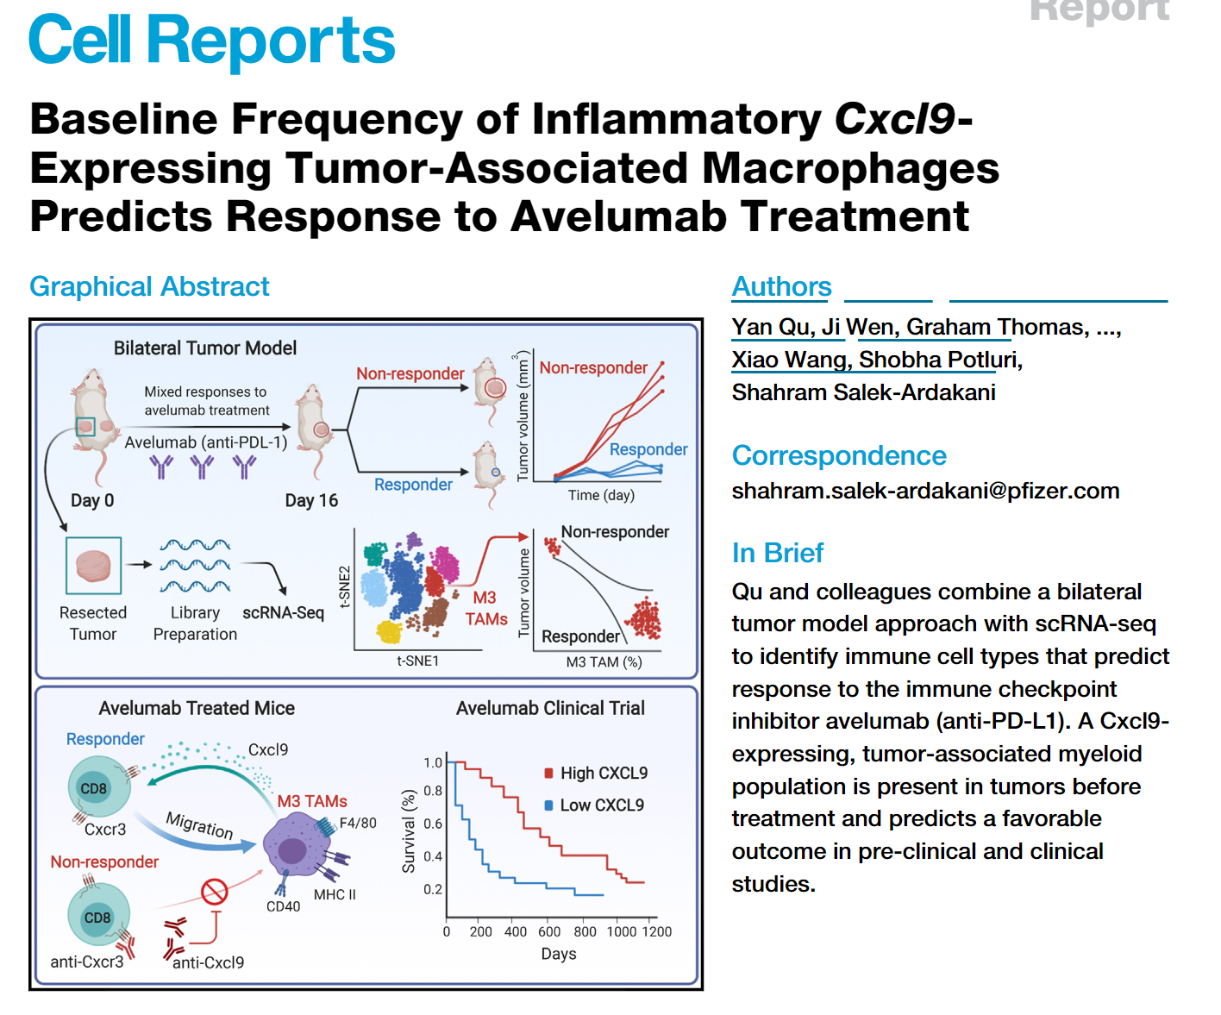
Selected Public Datasets
SRP166967
SRP262589

Slide 6
Dataset Comparisons
 | Estimated Total # of Cells | Mean Reads Per Cell | Median Genes per Cell | Sequencing Saturation | Reads Mapped to Intergenic Regions | Mapped to Transcriptome
10x PBMC | 9,247 (3,082) | 49,311 | 2,277 | 59.70% | NA | NA
SRP166967 | 50,008 (1,786) | 12,492 | 1,496 | 17.3% | 7.7% | 74.0%
SRP262589 | 452,460 (7,541) | 28,231 | 2,006 | 60.9% | 4.6% | 91.8%
BGI
Control | 20,574 (6,858) | 49,018 | 3,794 | 32.60% | 3.10% | 73.80%
Condition | 8,171 (4,085) | 82,000 | 3,441 | 55.70% | 3.60% | 71.20%
MIT
Control | 16,218 (5,406) | 76,790 | 1,914 | 56.10% | 8.40% | 52.40%
Condition | 4,495 (1,498) | 298,187 | 1,178 | 87.40% | 15.40% | 43.50%
() = average, BGI Condition had 1 failed sample

Slide 7
Public Dataset Comparisons

Slide 8
Analysis Design
SRP166967
12 samples run in technical duplicates (24)
Six syngeneic mouse tumor models
Identified Figures that highlighted:
Different Tumor Models
Cell Type Calling
Cell Type Calling Are different Between Authors vs H3
Our method does not have cancer type definitions
Authors use ‘high cluster density’ to assign cancer cells…not applicable to our use case
More refined cell type calling takes time

Slide 9
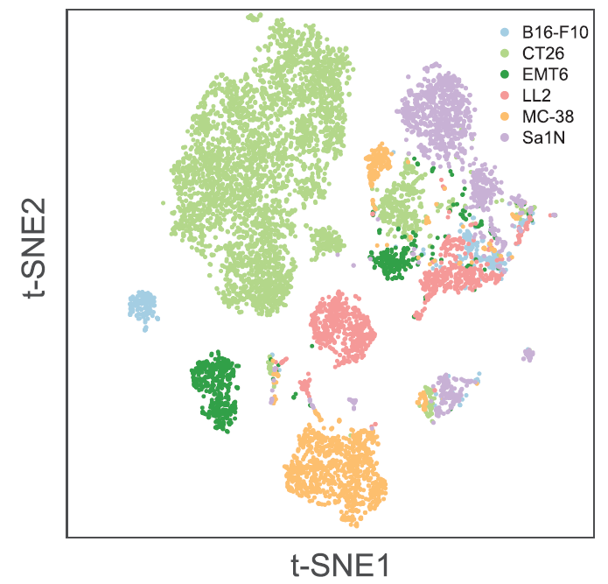
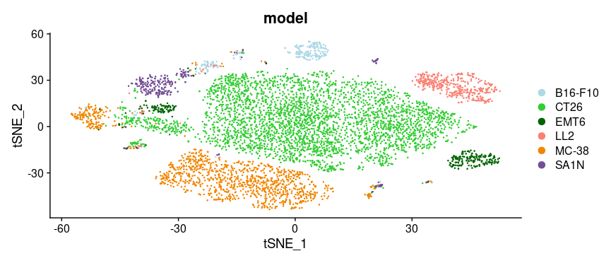
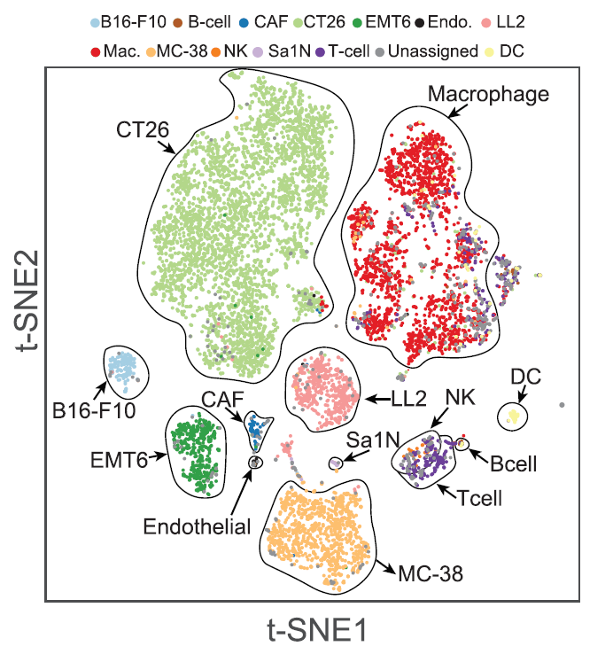
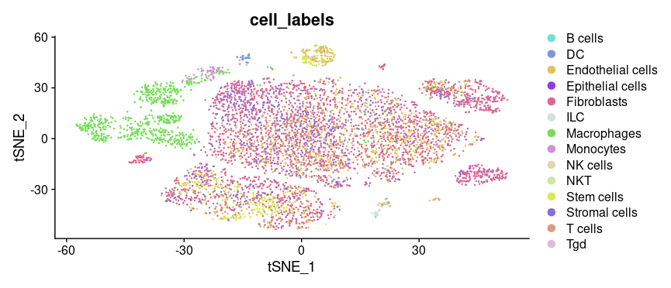
SRP166967: Figure 1B & 1D: Structure Preserved
Paper
H3
T-Sne Embeddings are similar
Changed Model Colors to be similar to make for easy comparison
Consistent with observed patterns in paper and other scRNA-Seq papers: Immune Populations are more similar between cancer models then cancer cells themselves
Immune Populations Match Similarly Cell Type Calling

Slide 10
SRP166967: Figure 1B & 1D: Structure Preserved
Paper
H3
T-Sne Embeddings are similar
Changed Model Colors to be similar to make for easy comparison
Consistent with observed patterns in paper and other scRNA-Seq papers: Immune Populations are more similar between cancer models then cancer cells themselves
Similar Immune Populations Cell Type Calling

Slide 11
Dataset: SRP262589
SRP262589
60 total mice (30 on avelumab, 30 not)
CD45+ TILs were FACS purified from CT26 tumors resected 8 days post s.c. implantation. Tumor sampled was a single tumor belonging to a bilateral pair, following resection mice were treated with avelumab to allow correlation of pre-treatment tumor immune cell profiles with treatment response.
Identified Figures that focused on:
Cell Type Calling
Response vs Not Response
Focused on Myeloid Population
Dataset was too large to load at once
Downsampled: 90k cells (max 100k cells), 20 samples (10 responders / 10 nonresponders)
Full Dataset: 60 samples, >400k cells
Server limitations ~load 20 samples at a time
Plot limitations: 100k cells can be plotted

Slide 12
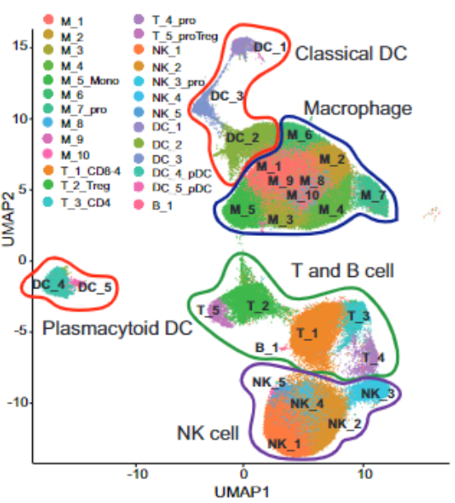
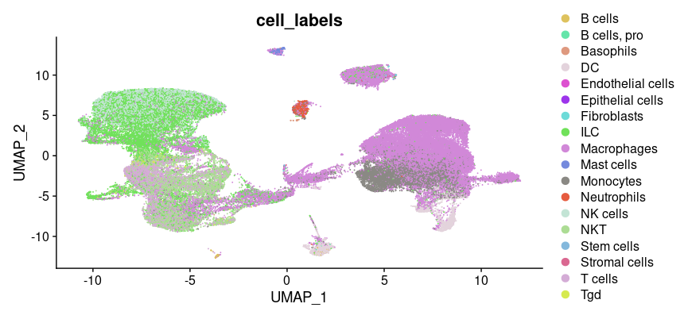
SRP262589: Figure 1D: Overall Structure Preserved
Paper
H3
Overall Structure preserved
There are some differences
Could be an artifact of downsampling or selecting a subset of samples

Slide 13
SRP262589: Figure 1D: Overall Structure Preserved
Paper
H3
Overall Structure preserved
There are some differences
Could be an artifact of downsampling or selecting a subset of samples

Slide 14
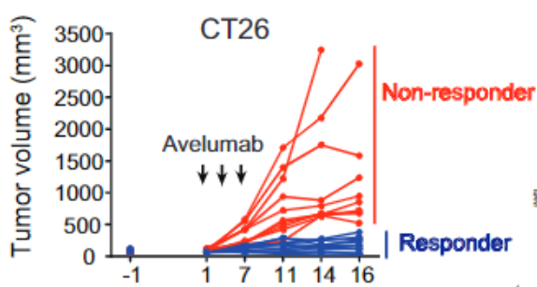
Using Fig 1 A To Define Data as Responder / Non
Paper does not mention definition of Responder / Non-Responder
500 mm³ seems to be threshold
Resulting in
38 Responders : 22 Non-Responders

Slide 15
Using Fig 1 A To Define Data as Responder / Non
Paper does not mention definition of Responder / Non-Responder
500 mm³ seems to be threshold
Resulting in
38 Responders : 22 Non-Responders

Slide 16
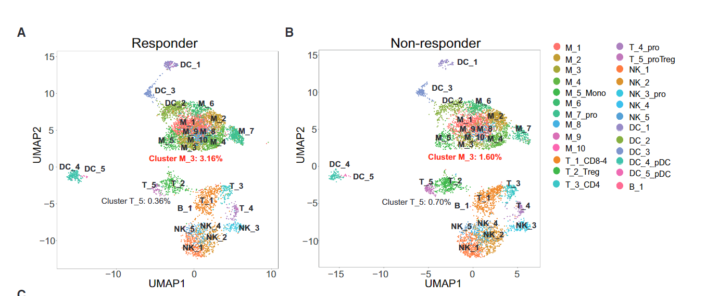
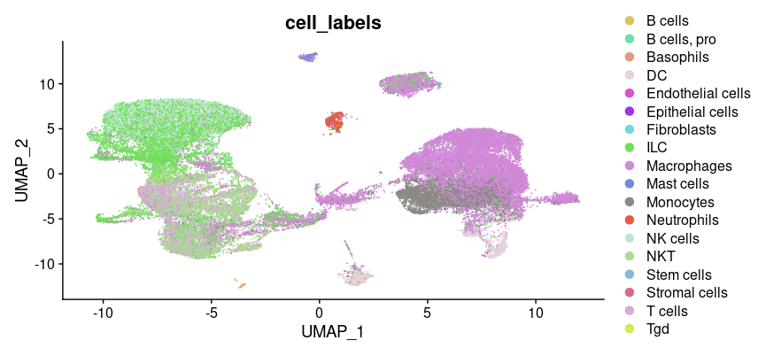
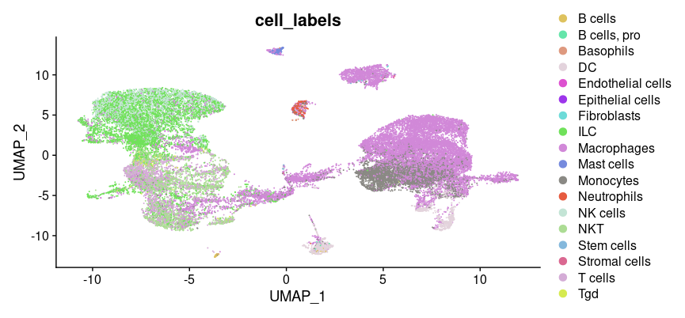
Fig 2 A & B: Overall Structure Preserved
Structure is Preserved
Paper highlights a key difference is subcluster “M_3”
That difference is very subtle: real?
Paper
H3

Slide 17
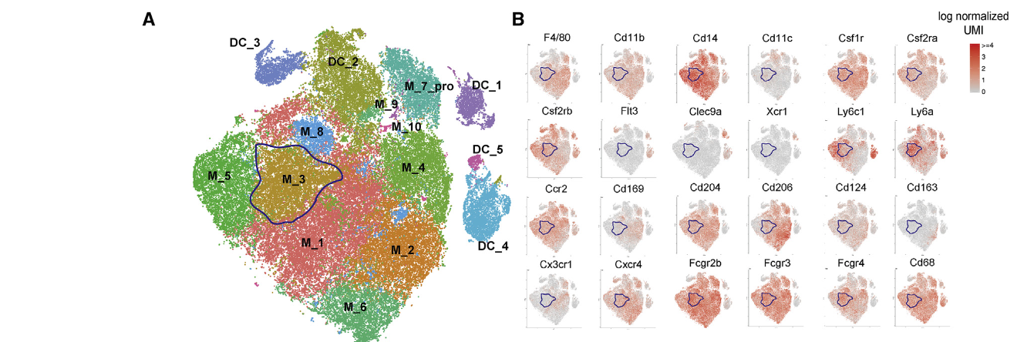
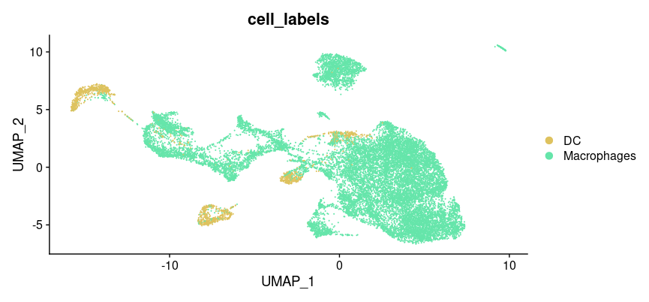
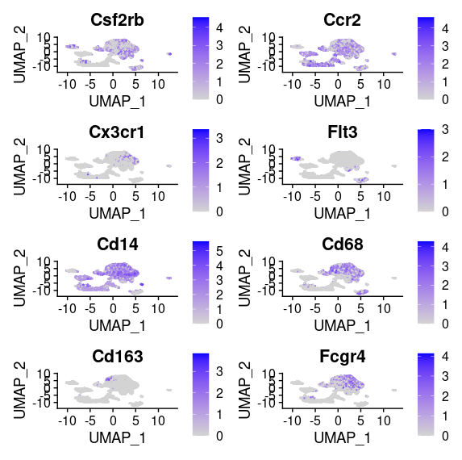
Figure 3 A / B: Overall Structure Preserved
Subset data to myeloid population
Figure does gradient for various genes of interest
Overall Structure Preserved
Additional macrophages selected are due to their cell type calling does not allow T / B Cell / macrophage mix
Paper
H3

Slide 18
Figure 3 A / B: Overall Structure Preserved
Subset data to myeloid population
Figure does gradient for various genes of interest
Overall Structure Preserved
Additional macrophages selected are due to their cell type calling does not allow T / B Cell / macrophage mix
Paper
H3

Slide 19
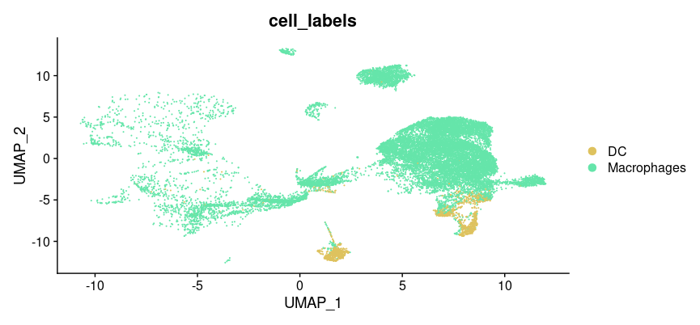
Figure 3 A / B: Original UMAP Representation
Additional macrophages selected are due to their cell type calling does not allow T / B Cell / macrophage mix

Slide 20
Pilot scRNA-Seq Results

Slide 21
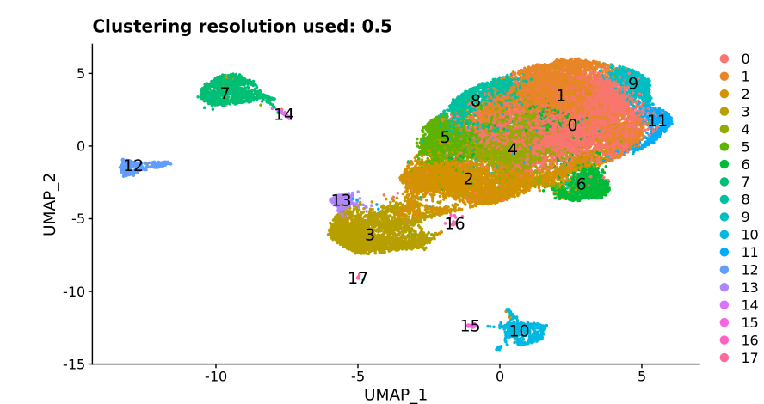
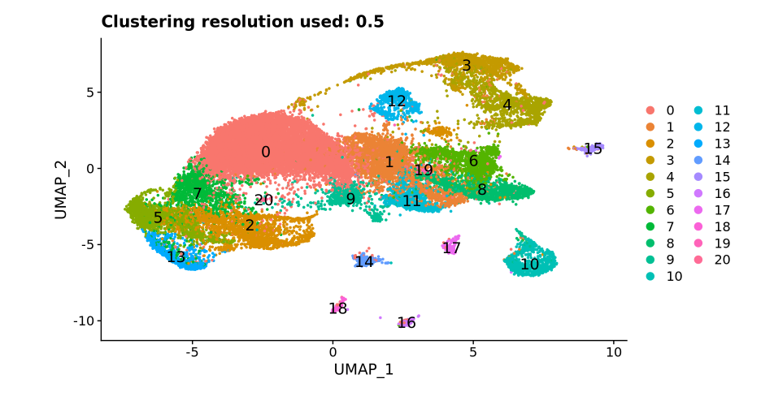
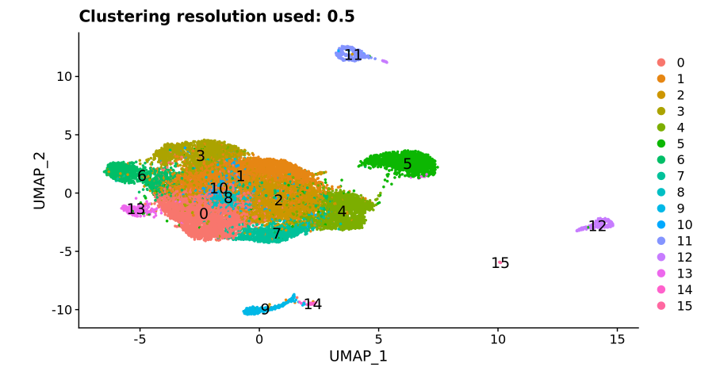
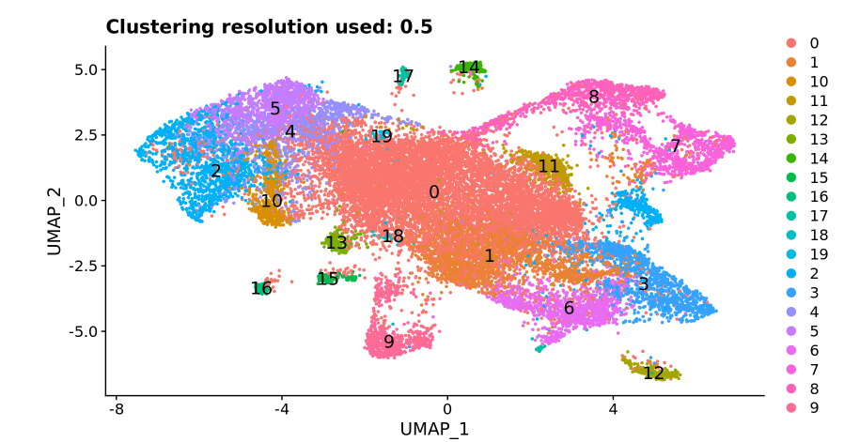
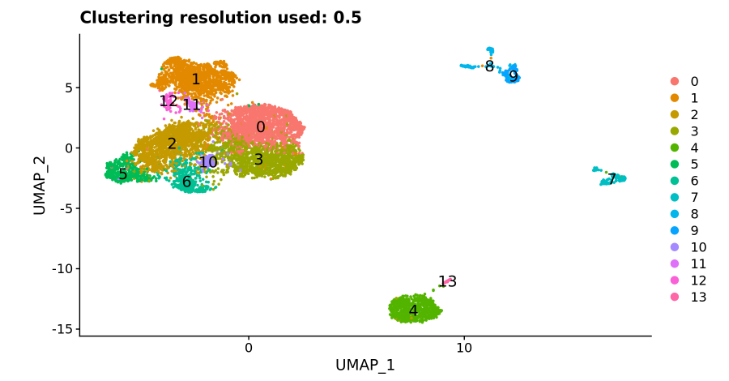
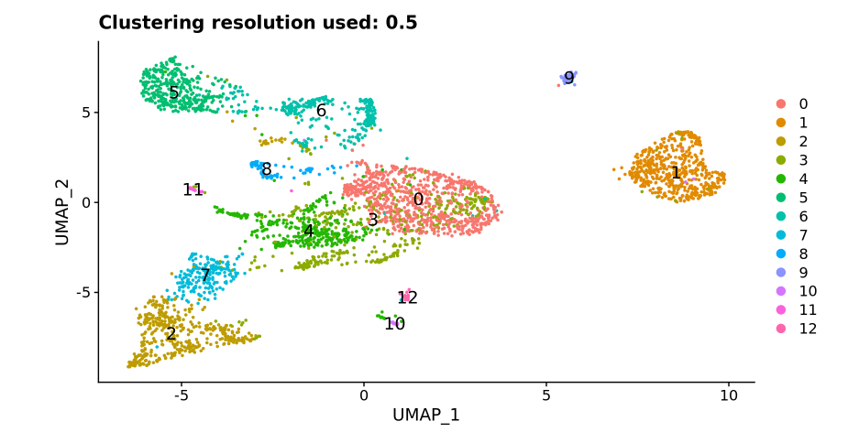
Overall Pattern
MIT
BGI
Complete
Control
Condition

Slide 22
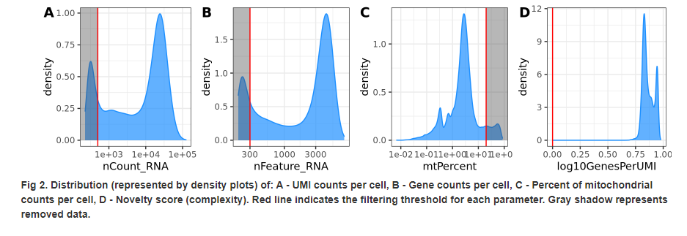
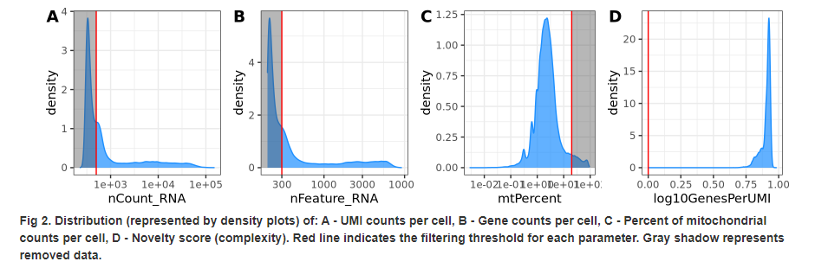
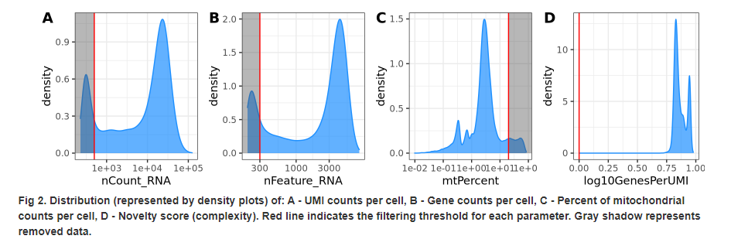
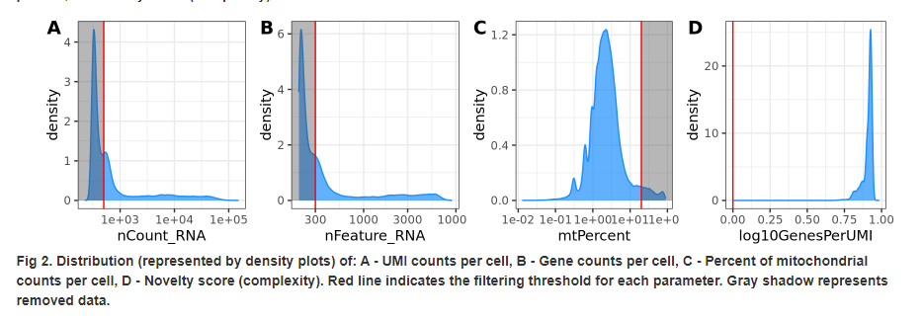
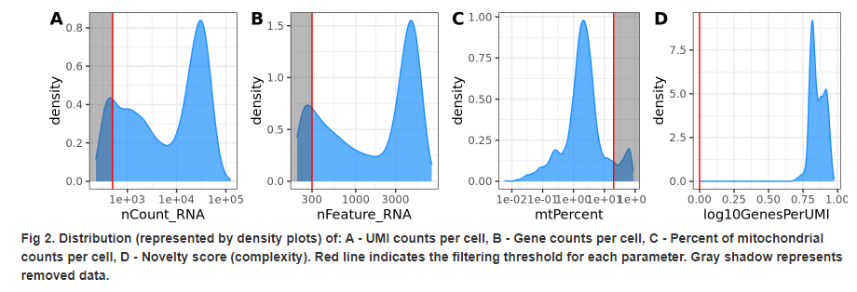
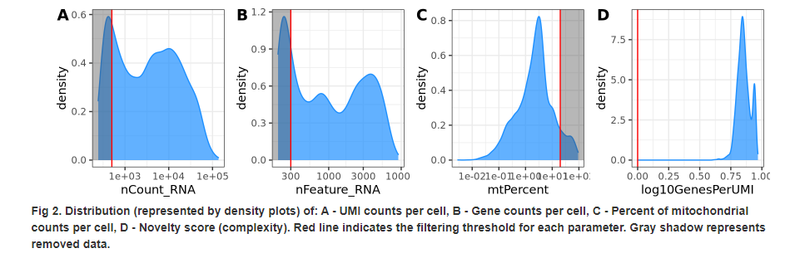
Distribution & Sampling Depth
BGI
MIT
Complete
Control
Condition

Slide 23
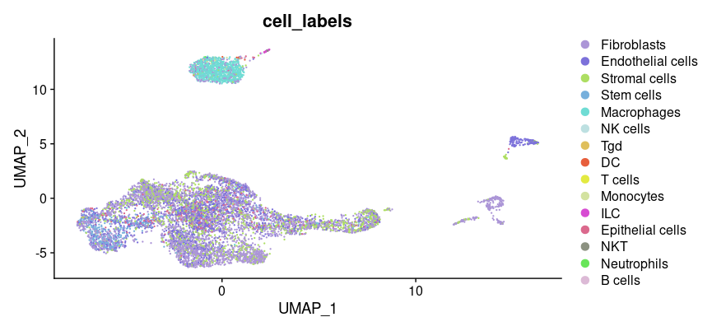
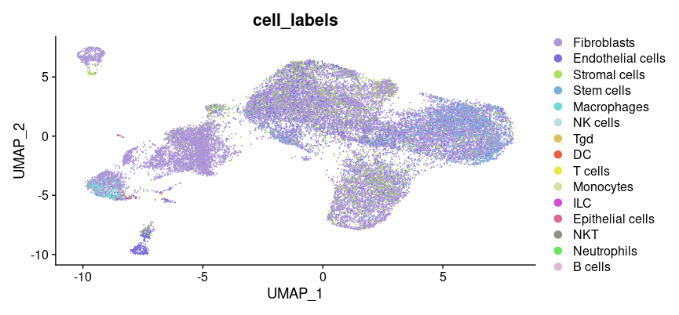
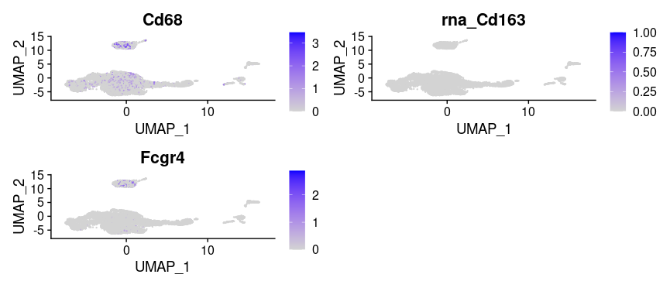
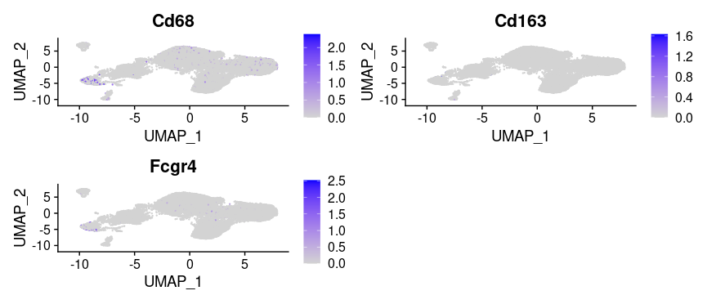
Despite Noisy: Able To Get Some Patterns
BGI Condition
BGI Control

Slide 24
Despite Noisy: Able To Get Some Patterns
BGI Condition
BGI Control

Slide 25
Backup

Slide 26
A lot of Noise on scRNA-Seq Cell Type Calling

Slide 27
Removing Fibroplasts and Epithelial Does Not Change

Slide 28
Lower Complexity

Slide 29
HER2-STING ADC induces significant tumor cell loss in CT-26/HER2 model
*
*

Slide 30
Thawed CD45+ TILs maintain good viability (>80%) with modest reduction in cell number
1.3 M
0.7 M
CD45+ purity (80.0% for untreated and 92.3% for treated sample)
Cell concentration needs to be 700-1,200 cells/μl prior to run 10x Genomics Single Cell protocols, only need to load 5k to 10k cells

Slide 31
Freeze/thaw process has minimum impact on TIL composition
CD11b+, Ly6G+, Ly6Clow
CD11b+, Ly6G-, Ly6Chigh
CD11b+, F4/80+, Ly6C-, Ly6G-
CD3+, CD8-, CD4+
CD3+, CD8+, CD4-
CD3-, NKp46+

Slide 32
HER2-STING ADC activates immune cells in CT26 tumors
Macrophage
CD8 T cell

Slide 33
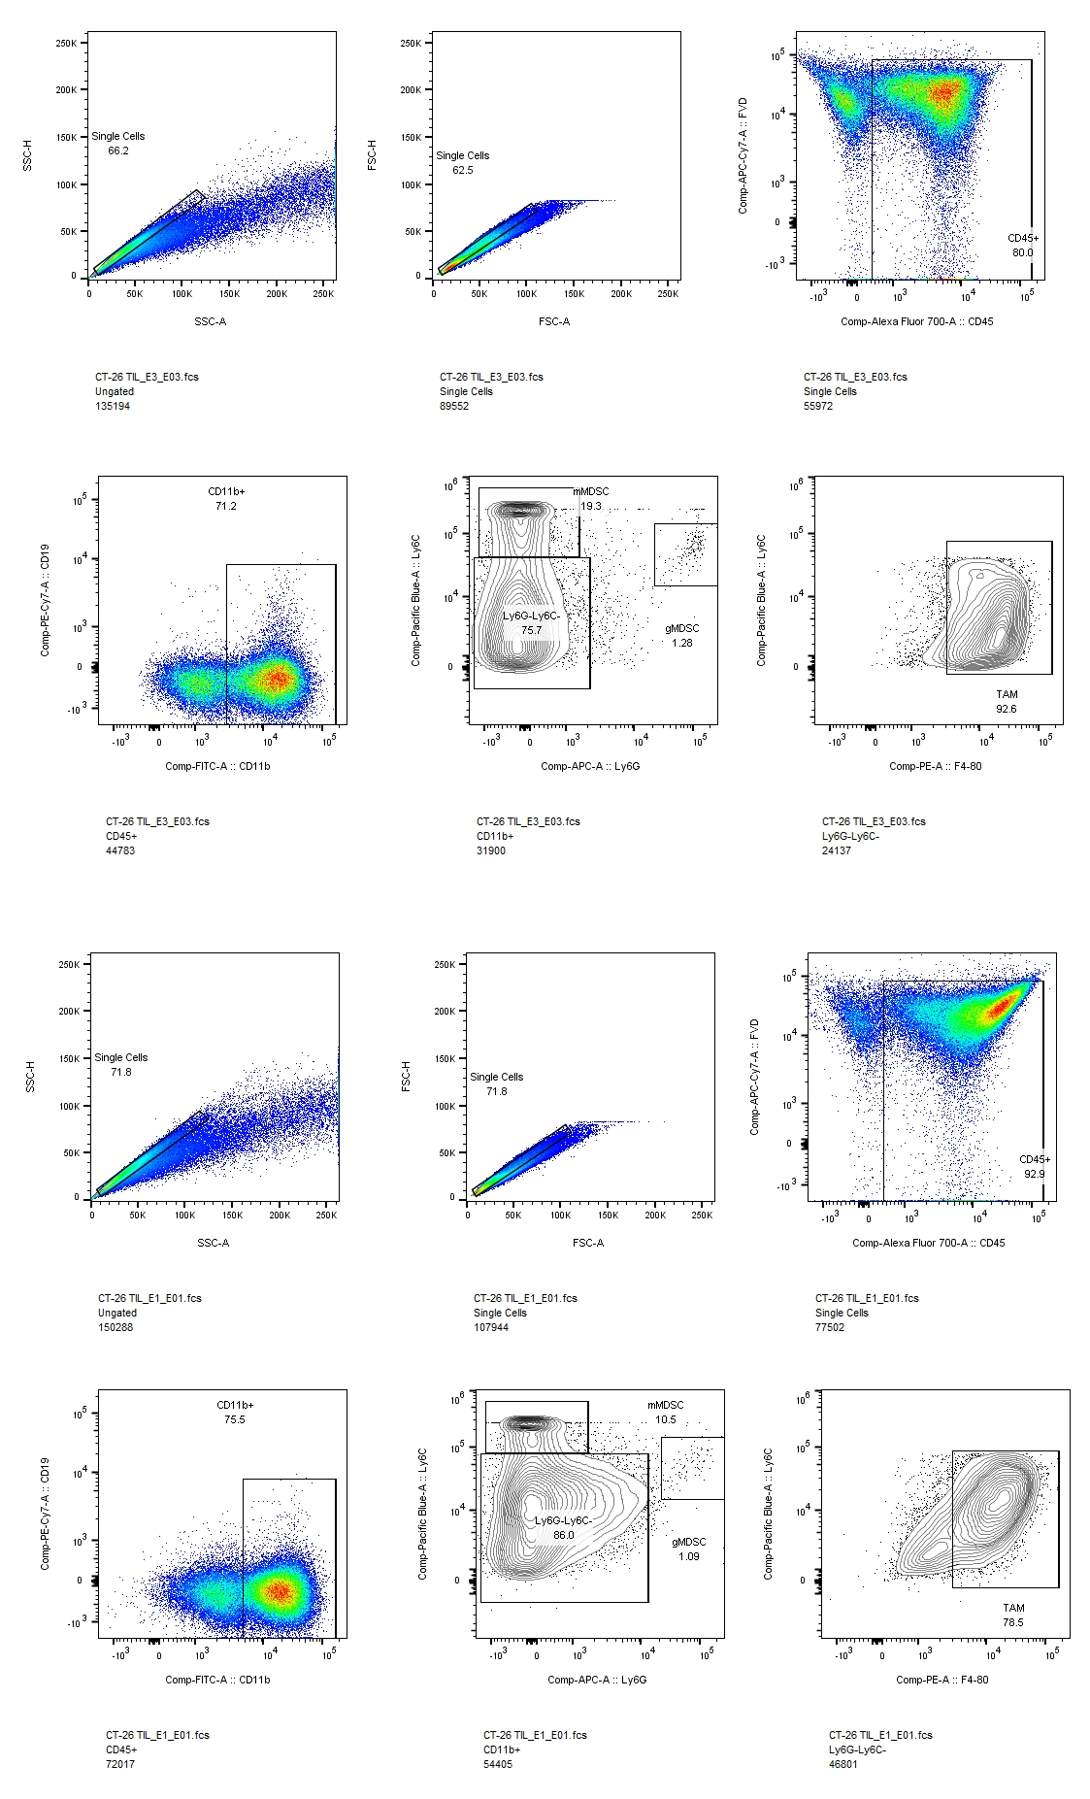
Gating strategy for myeloid panel

Slide 35
SRP166967 Outline
Load In All Cells
37,242 cells
Applying Filters in paper = 11,863 cells (paper states 10,573 cells)
Paper Conditions
Each cell must have at least 1,500 genes with 1 read count
Transforms Counts to TPM
Normalize Expression to >3,000 housekeeping genes
Cell type caller reference based on less robust reference
H3 Method
Gene, Count, and Mitochondrial Contamination

Slide 36
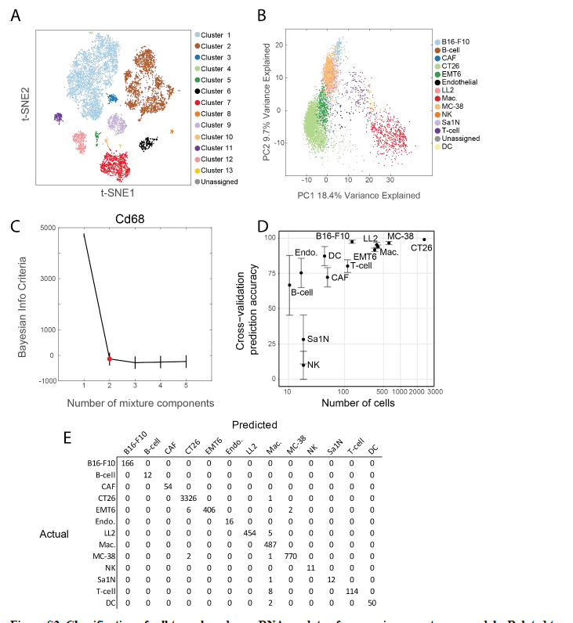
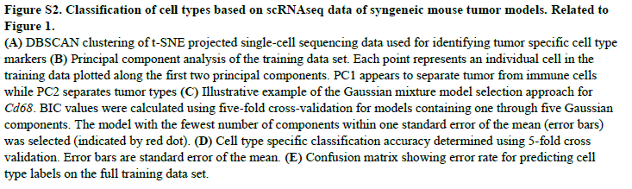
SRP166967 (Possible Alternate Figure)

Slide 37
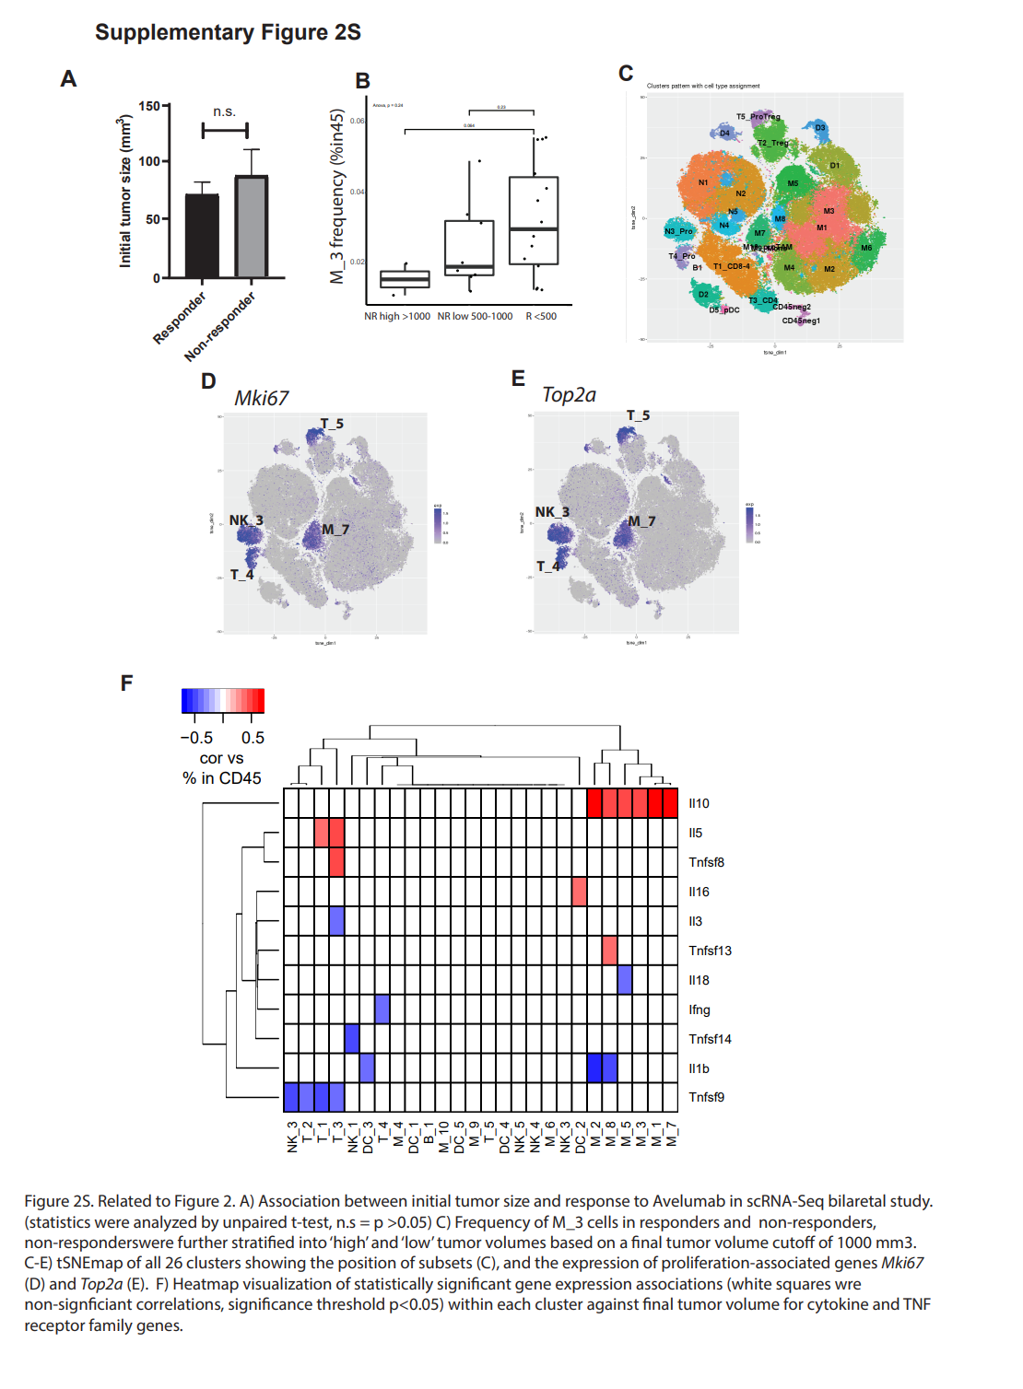
Supplement Figure 2S C

Slide 38
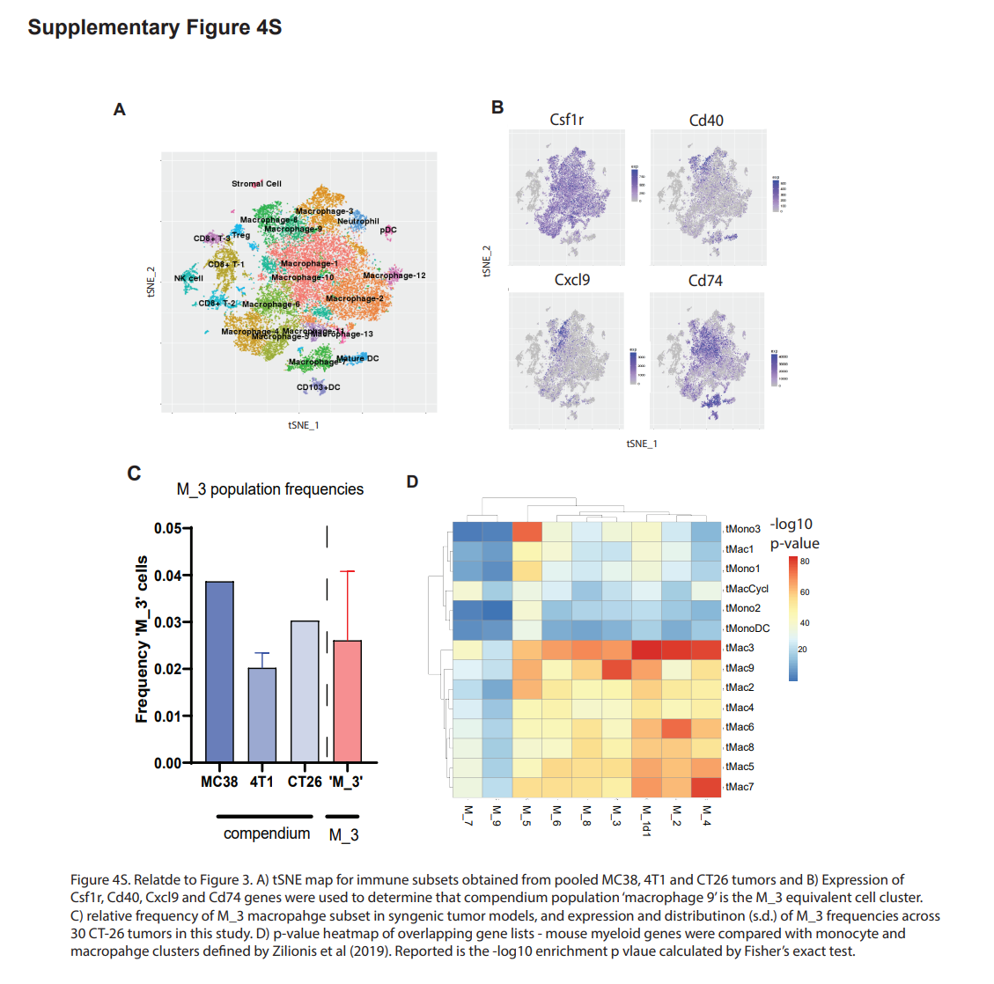
4S A (from a different dataset)

Slide 39
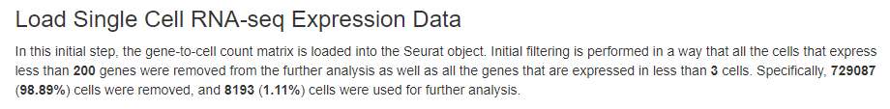
Quality Control Evaluation (Report)
Next few slides represent a pdf report for a scRNA-Seq analysis as possible deliverable for an H3 scRNA-Seq analysis
Report Start

Slide 40
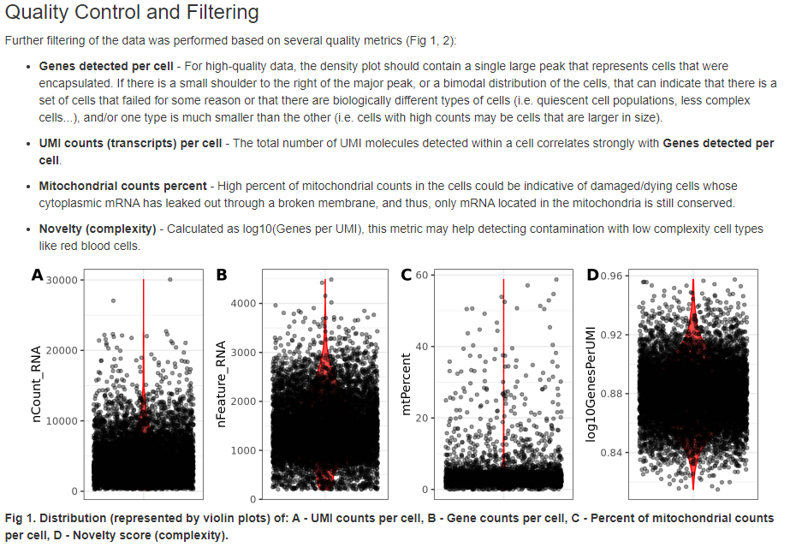
Quality Control and Filtering Part 1

Slide 41
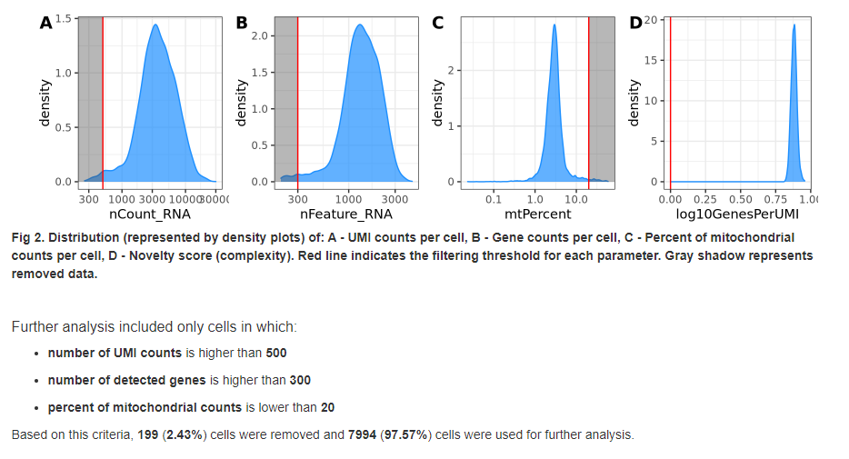
Quality Control and Filtering PT 2

Slide 42
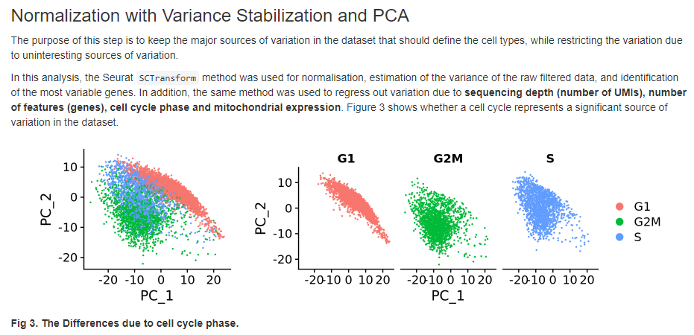
Analyzing Sources of Variation: Cell Cycle Phase

Slide 43
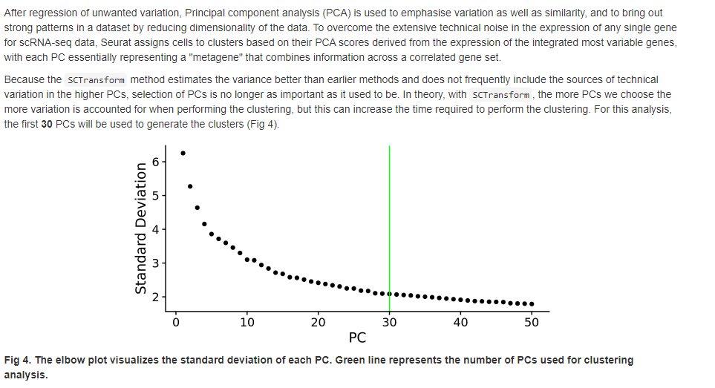
Balancing variation and similiarity

Slide 44
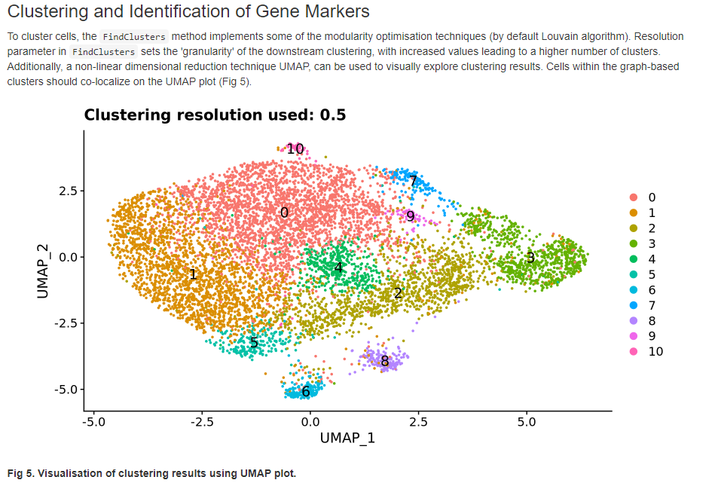
Identifying clusters and gene markers per cluster

Slide 45
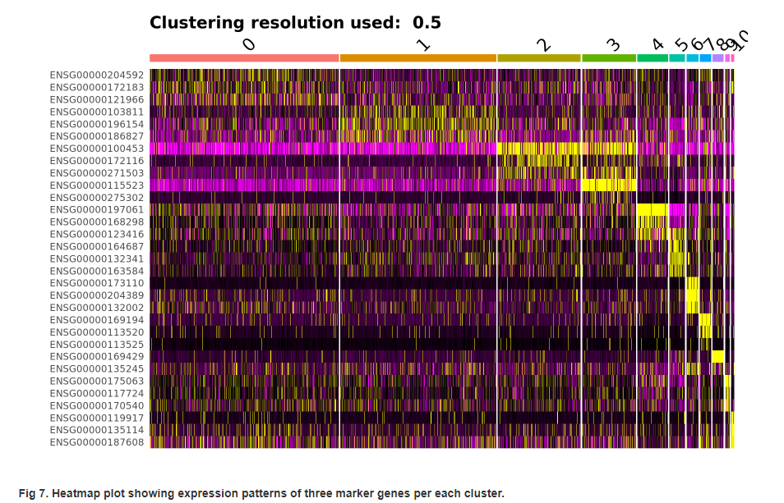
Heatmap Representations between different clusters

Slide 46
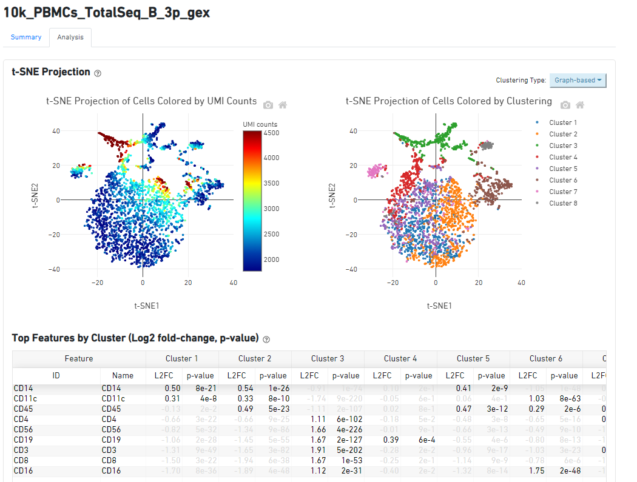
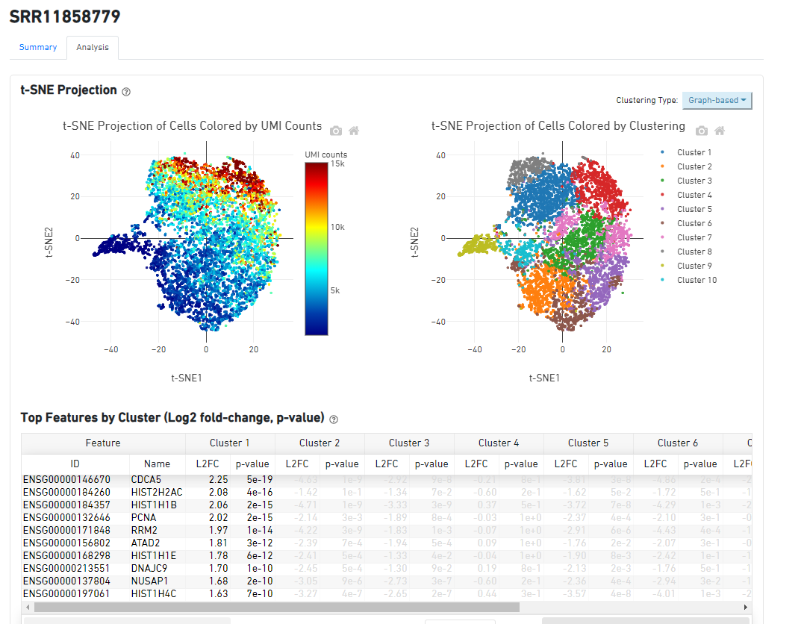
2 Dataset Examples from H3 Evaluation

Slide 47
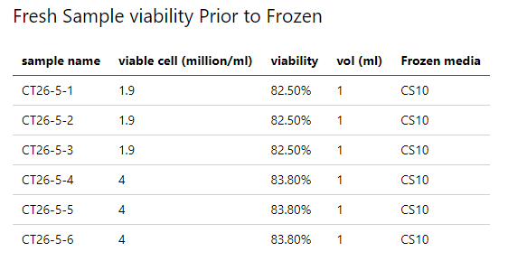
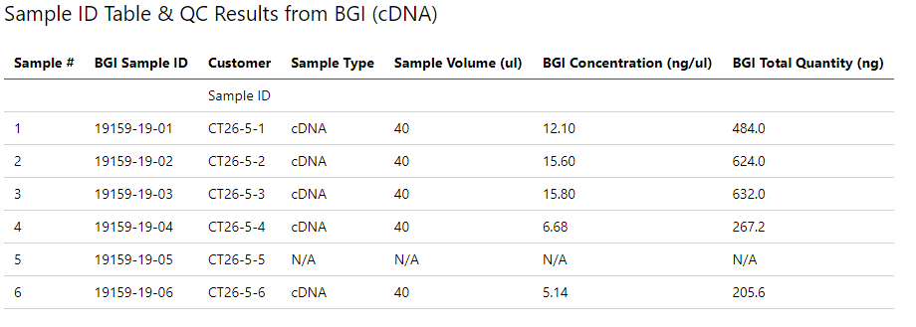
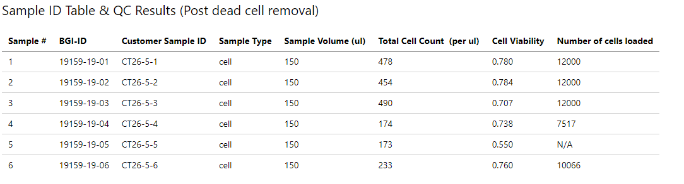
Sample Quality Control
Fresh Sample
had consistent viability
Sample 1-3: 1.9 million
Sample 4-6: 4 million
Library Preparation & QC
Quality and Cell Loading different between 1-3 vs 4-6
Cell Viability, inconsistent despite the consistent viability

Slide 48
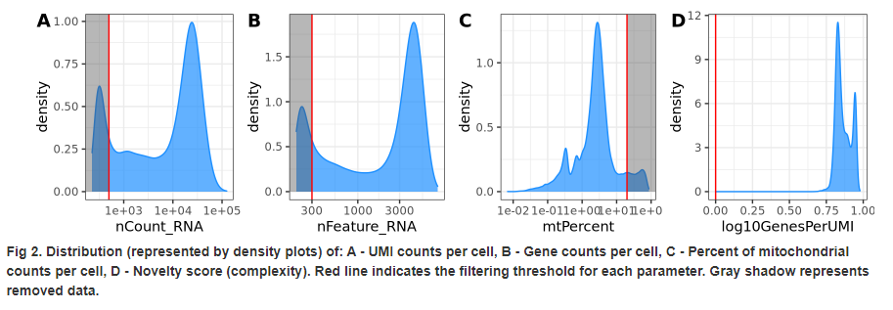
Distribution of UMI, Gene Counts, Mitochondrial

Slide 49

UMAP of Data

Slide 50




10k PMBC Results

Slide 51
Distribution & Sampling Depth
10X
BGI
MIT
Control
Condition

Slide 52
Distribution & Sampling Depth
BGI
MIT
Complete
Control
Condition

Slide 53
Cell Type By Sample Percentage

Slide 54
BGI Percentage Pie Charts
Control
Condition

Slide 55
MIT Percentage Pie Charts
Control
Condition

Slide 56
Quality Control Evaluation (Report)
Next few slides represent a pdf report for a scRNA-Seq analysis as possible deliverable for an H3 scRNA-Seq analysis
Report Start

Slide 57
Quality Control and Filtering Part 1

Slide 58
Quality Control and Filtering PT 2

Slide 59
Analyzing Sources of Variation: Cell Cycle Phase

Slide 60
Balancing variation and similiarity

Slide 61
Identifying clusters and gene markers per cluster

Slide 62
Heatmap Representations between different clusters

Slide 63
2 Dataset Examples from H3 Evaluation

Slide 64
Goal & Datasets
First pass analysis to assess the quality & Cell type Calling of Pilot scRNA-Seq Data
3 Datasets
10k PMBC (Comparison)
BGI
MIT

Slide 65
Distribution & Sampling Depth
BGI
MIT
Complete
Control
Condition

Slide 66
Distribution & Sampling Depth (Compared to ‘easy’ dataset)
10k PMBC Control Dataset
BGI
MIT
Control
Condition

Slide 67
Gating strategy for myeloid panel

Slide 69
Distribution of UMI, Gene Counts, Mitochondrial

Slide 70
UMAP of Data

Slide 71



Slide 72



Slide 73


Cell Ranger Basic Metrics

Slide 74

Costs to Process
SRP262589
SRP166967
*Working with Chase to get better cost resolution to summarize what processing public scRNA-Seq would cost
** With some pipeline re-working can be faster & cheaper overall

Slide 75


Default Images Generated Via Pipeline (Cell Ranger)

Slide 76


Default Images Generated Via Pipeline (QC Filtering)
PDF Report
Multiple Images

Slide 77





Default Images Generated Via Pipeline (QC Filtering)

